Slide 1
CFA: A Practical Prediction System for Video Quality Optimization
Junchen Jiang, Vyas Sekar, Henry Milner, Davis Shepherd, Ion Stoica, Hui Zhang

Slide 2
One-Minute Overview
Prediction leads to dramatic quality improvement
Predicting video quality is very challenging
Persistence of critical features ➔ CFA

Slide 3
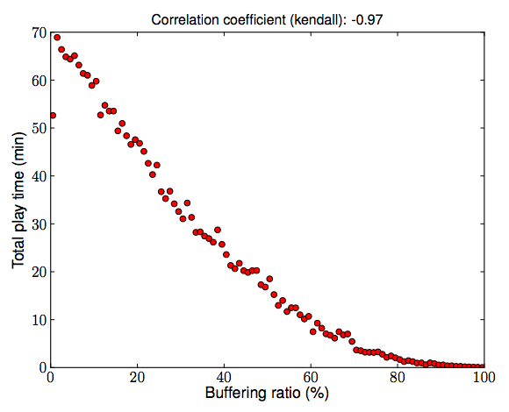
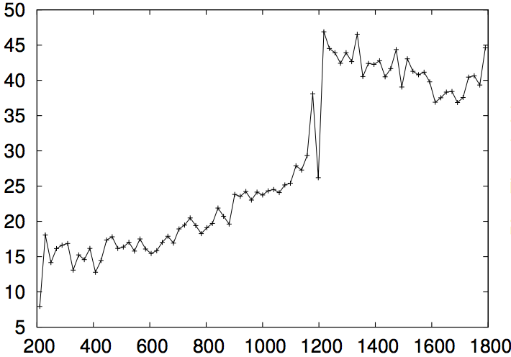

Internet Video Quality Matters!
40% sessions
13% sessions
User Engagement
User Engagement
Avg Bitrate
Buffering ratio
Better quality
➔
Longer user Engagement
➔
More revenues!
A significant room of improvement!

Slide 4
New Paradigm: Centralized Control Platform
Prediction
Oracle
Answer “What-if” questions.
e.g., What if I use 400Kbps, Akamai?
Local reactive adaptation is too slow
Fundamentally crippled for initial selections
A Case for Centralized Control Plane
Real-time global network view ➔ Prediction Oracle
e.g., potentially 50% less re-buffering [SIGCOMM12,NSDI15]
Local adaptation
Internet
400Kbps
1Mbps
400Kbps
1Mbps

Slide 5
Key Missing Piece: How to Build a Prediction Oracle?
CFA
Our contribution: Critical Feature Analytics (CFA)
Data-Driven Video Quality Prediction System
Prediction
Oracle
Internet
400Kbps
1Mbps
400Kbps
1Mbps

Slide 6
Outline
Motivation
➔ Challenges of Video Quality Prediction System
The CFA Approach
Evaluation

Slide 7
Why is Building a Quality Prediction System Challenging?
Trains a Quality Prediction Model
Pred(quality of other sessions)
Quality of other sessions
Quality prediction for new sessions
Challenge 1: Complex factors affect video quality
➔ Need expressive models to capture these factors
Challenge 2: Video quality changes quickly
➔ Need to refresh predictions in near real-time (e.g., 30 sec)

Slide 8



Challenge 1: Complex relation between video quality and features
NY
Comcast
Level3 CDN
PIT
AT&T
Akamai
Quality depends on combinations of features
City | ASN | CDN | Video | Device | Quality
NY | Comcast | Level3 | “Foo” | “bar”
PIT | Comcast | Level3 | “Foo” | “bar”
NY | AT&T | Level3 | “Foo” | “bar”
NY | Comcast | Akamai | “Foo” | “bar”

Slide 9
Such feature combinations differ cross clients & time
Time | City | ASN | CDN | Video | Device | Quality
3:00PM | NY | Comcast | Level3 | “foo” | “bar”
3:00PM | PIT | Comcast | Akamai | “foo” | “bar”
7:00PM | PIT | Comcast | Akamai | “foo” | “bar”
Combinational effects: Quality depends on combinations of multiple features
Spatial diversity: Quality-determining features differ cross clients
Model drift: Quality-determining features change over time

Slide 10
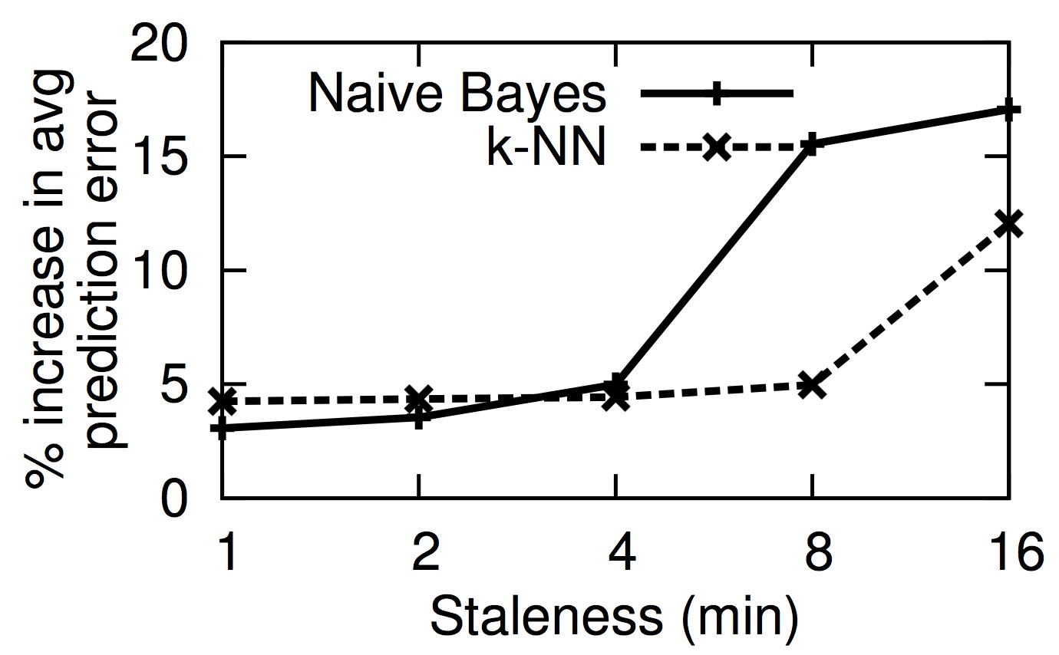
Challenge 2: Video Quality Changes Quickly
Using fresh quality measurement is critical!

Slide 11
Needs both model expressiveness & fast update
Not expressive enough to model complex factors
e.g., NaiveBayes, Decision Tree
Algorithm for Problems that have “Persistent” critical features
Fast
Simple ML
CFA
Update speed
Needs tens of min to update model, Not interpretable
e.g., SVM
Better
Complex ML
Slow
Low
High
Expressiveness

Slide 12
Outline
Motivation
Challenges
➔ The CFA Approach
Evaluation

Slide 13
The Basic CFA Workflow: Similar feature values short history ➔ similar quality
All historical sessions with observed quality
Session under prediction
Similar sessions to s
Finding similar sessions
Quality estimate
(e.g., median)
Quality prediction
for s
s
Strawman: Matching on all features
Curse of dimensionality:
Hard to find sessions matching on all features
 | Accurate | Reliable
Matching on all features | ✔ | ✖

Slide 14

Insight to Find Similar Sessions: Critical Features
Critical features: subset of features ultimately determines video quality
City | ASN | CDN | Content | Device
NY | Comcast | Level3 | “foo” | “bar”
Quality
F( )
$$≈$$
Strawman: Matching on all features in the last minute
F( )
NY | Comcast | Level3 | * | *
Use sessions matching “NY, Comcast, Level3, foo, bar” in last minute
Enough sessions matching “NY, Comcast, Level3” in last minute
Curse of dimensionality:
Few sessions matching on all features in one minute
s

Slide 15
The CFA Workflow Based on Critical Features
Similar sessions to s
Finding similar sessions
Quality estimate
(e.g., median)
Quality prediction
for s
s
Matching on Critical Features
Finding Critical feature of s
 | Accurate | Reliable
Matching on all features | ✔ | ✖
Matching on critical features | ✔ | ✔
How to get critical features?

Slide 16
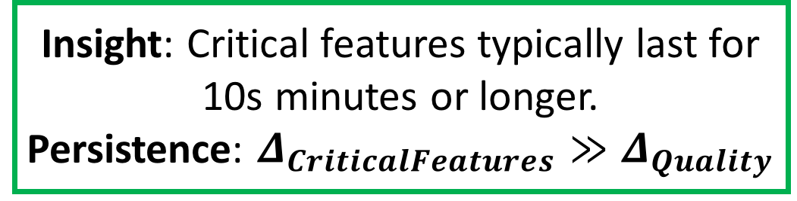
Insight to Learn Critical Features: Critical Features are Persistent
Insight: Critical features typically last for 10s minutes or longer.
Persistence: $Δ_{CriticalFeatures}≫Δ_{Quality}$
Strawman:
Learn Critical Features over last minute
Curse of dimensionality:
No data of ground truth
Longer history ➔ Enough sessions to construct ground-truth quality
s
CFA approach: Learn Critical Features over last hour

Slide 17
How to Estimate Quality with Fresh Updates?
Similar sessions to s
Finding similar sessions
Quality estimate
(e.g., median)
Quality prediction
for s
s
Matching on Critical Features
A few seconds
A few seconds
Finding Critical feature of s
Takes 10s minutes

Slide 18
CFA Approach to Fresh Updates
Estimate quality
(every tens of sec)
Sequential workflow
Learn critical features
(every tens of min)
Learn critical features
(every tens of min)
Enabled by Persistence of Critical Features
Time
Learn critical features
(every tens of min)
Learn critical features
(every tens of min)
Slow path
Decoupled workflow
Fast path

Slide 19
Putting Everything Together: CFA Implementation
The C3 platform [NSDI’15]
Backend cluster
Learn critical features + estimate quality
Update quality prediction per 10s of sec
Geo-distributed frontend clusters
Pick the (CDN, bitrate) of the best predicted quality and return it in 10s of ms
Video clients

Slide 20
Outline
Motivation
Challenges
The CFA Approach
➔ Evaluation

Slide 21
Real-world A/B Testing
32% reduction
12.3% increase
Substantial quality improvement by CFA.

Slide 22
CFA vs. Strawman Prediction Algorithms (Decision tree, Naïve Bayes, kNN, Last-mile, ASN-based etc)
23% less error
16% higher bitrate
CFA is more accurate
CFA leads to better quality

Slide 23
Conclusion
Higher video quality ➔ Long user engagement ➔ More revenues!
Prediction has huge potential but is also challenging:
Quality-determining features are complex, heterogeneous and dynamic.
CFA uses domain-specific insights
Video quality depends on a subset of persistent critical features.
CFA leads to 30% less buffering ratio and 12% high bitrate
Key takeaway:
Prediction ➔ Performance improvement
Persistence of critical features ➔ Accurate prediction

